Slide 1
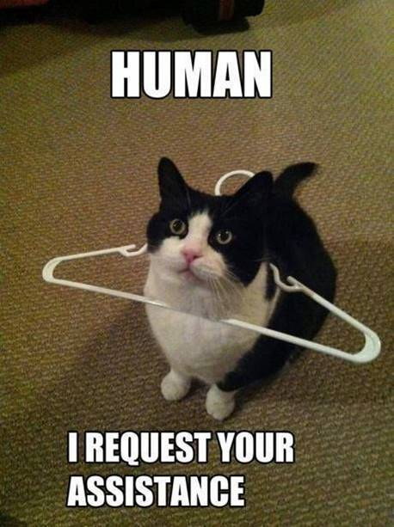
Timeline
Grammar: Beschrijven
Work from the book
Goal: being able to give a discription
of people and things
Notes:
Afbeelding: https://www.flickr.com/photos/studiodxavier/6063335422

Slide 2
Grammar – Beschrijven
Make assignment A on your worksheet.
We will check the answers together in 5 minutes.
Maak opdracht A op je werkblad.
We controleren de antwoorden over 5 minuten.

Slide 3
Grammar – Bijvoeglijk naamwoord en Bijwoord
Now you. Circle the correct word in these sentences.
We will check the answers in 5 minutes.
She sang beautiful/ beautifully.
I asked him polite/ politely.
He is a careful/ carefully man.
These nice/ nicely girls shared their food with that guy.
You have to come home immediate/ immediately.

Slide 4
Grammar – Bijvoeglijk naamwoord en Bijwoord
Now you. Circle the correct word in these sentences.
We will check the answers in 5 minutes.
She sang beautiful/ beautifully.
I asked him polite/ politely.
He is a careful/ carefully man.
These nice/ nicely girls shared their food with that guy.
You have to come home immediate/ immediately.

Slide 5
Grammar – Bijvoeglijk naamwoord en Bijwoord
Now you. Circle the correct word in these sentences.
We will check the answers in 5 minutes.
She sang beautiful/ beautifully.
I asked him polite/ politely.
He is a careful/ carefully man.
These nice/ nicely girls shared their food with that guy.
You have to come home immediate/ immediately.

Slide 6
Grammar – Bijvoeglijk naamwoord en Bijwoord
Now you. Circle the correct word in these sentences.
We will check the answers in 5 minutes.
She sang beautiful/ beautifully.
I asked him polite/ politely.
He is a careful/ carefully man.
These nice/ nicely girls shared their food with that guy.
You have to come home immediate/ immediately.

Slide 7
Grammar – Bijvoeglijk naamwoord en Bijwoord
Now you. Circle the correct word in these sentences.
We will check the answers in 5 minutes.
She sang beautiful/ beautifully.
I asked him polite/ politely.
He is a careful/ carefully man.
These nice/ nicely girls shared their food with that guy.
You have to come home immediate/ immediately.
If you’ve made NO mistakes you can skip my explanation and work from the book.

Slide 8
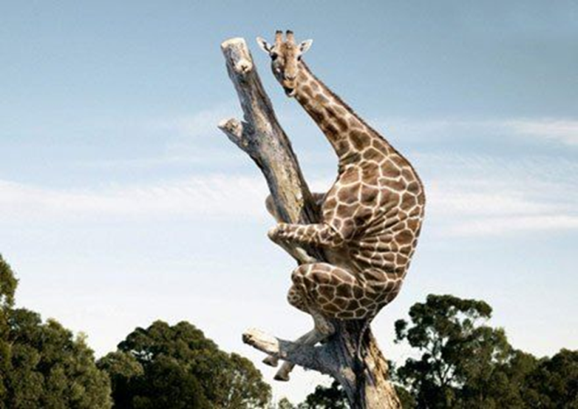
Grammar – Beschrijven
Fearful
Timmy is a fearful giraffe.
He holds on to the tree fearfully.

Slide 9
Fearful
Timmy is a fearful giraffe.
He holds on to the tree fearfully.
Iets of iemand
Actie

Slide 10
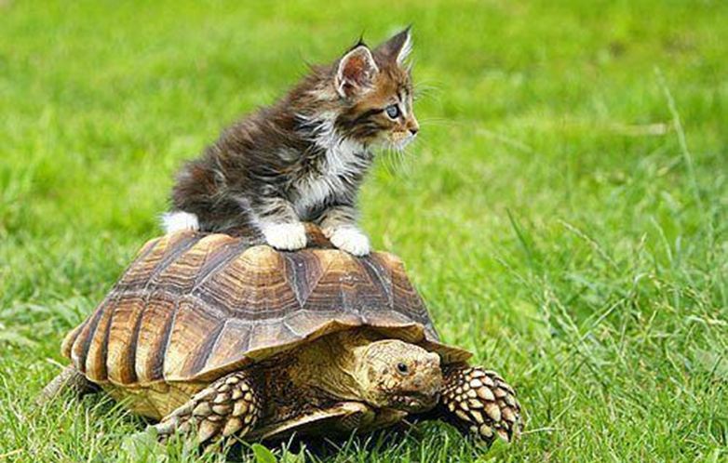
Slow
Thom is a ________ turtle.
He walks home _________.
Iets of iemand
Actie

Slide 11
Slow
Thom is a _slow_ turtle.
He walks home _________.
Iets of iemand
Actie

Slide 12
Slow
Thom is a _slow_ turtle.
He walks home _slowly_.
Iets of iemand
Actie

Slide 13
Grammar – Beschrijven
Bijvoegelijke naamwoorden (Adjectives) en Bijwoorden (Adverbs)
Zelfstandig naamwoord
= woorden waar je de, het of een voor kunt zetten
= woorden waar je a of an voor kunt zetten in het Engels
 | When Zegt iets over… | Rule | Signaalwoord
Bijvoeglijk naamwoord | Iets of iemand | Woord | Zelfstandig naamwoord
Bijwoord | Actie | Woord + ly | Werkwoord

Slide 14
Grammar – Beschrijven
Now finish assignments B and C.
You get 10 minutes to finish the assignments
You can discuss with your neighbour
We check the answers in class

Slide 15
Grammar – Beschrijven
B. At the start of the sentence is a word. Fill in the correct form of
the word in the gap.
Careful Timmy is a careful giraffe.
He climbed up the ladder carefully.
Angry The dog is angry.
It barks angrily .
Excellent He acted excellently.
He's an excellent actor.
Easy They learn English easily.
They think English is an easy language.
Good Laura is a good singer.
She sings well.

Slide 16
Grammar – Beschrijven
There is a word at the start of the sentence. Fill in the correct form
of the word in the gap.
1. Beautiful She is a _______________________ girl.
2. Fantastic We look _______________________ .
3. Ridiculous She talks _______________________ .
4. Soft Her voice is _______________________ .
5. Wonderful David cooks _______________________ .
6. Good This is a _______________________ movie.
7. Fast The Fast and the Furious is about _______ cars.
8. Good I can speak English very __________________ .
9. Fantastic She dresses _______________________ .
10. Happy The children play _______________________ .

